Slide 1
Eniac: discounts and revenue
Arpana, Dmitriy, Federico, Preston
Data Science Boot Camp - WBS CODING SCHOOL

Slide 2
Main question
Whether or not it’s beneficial to discount products?

Slide 3
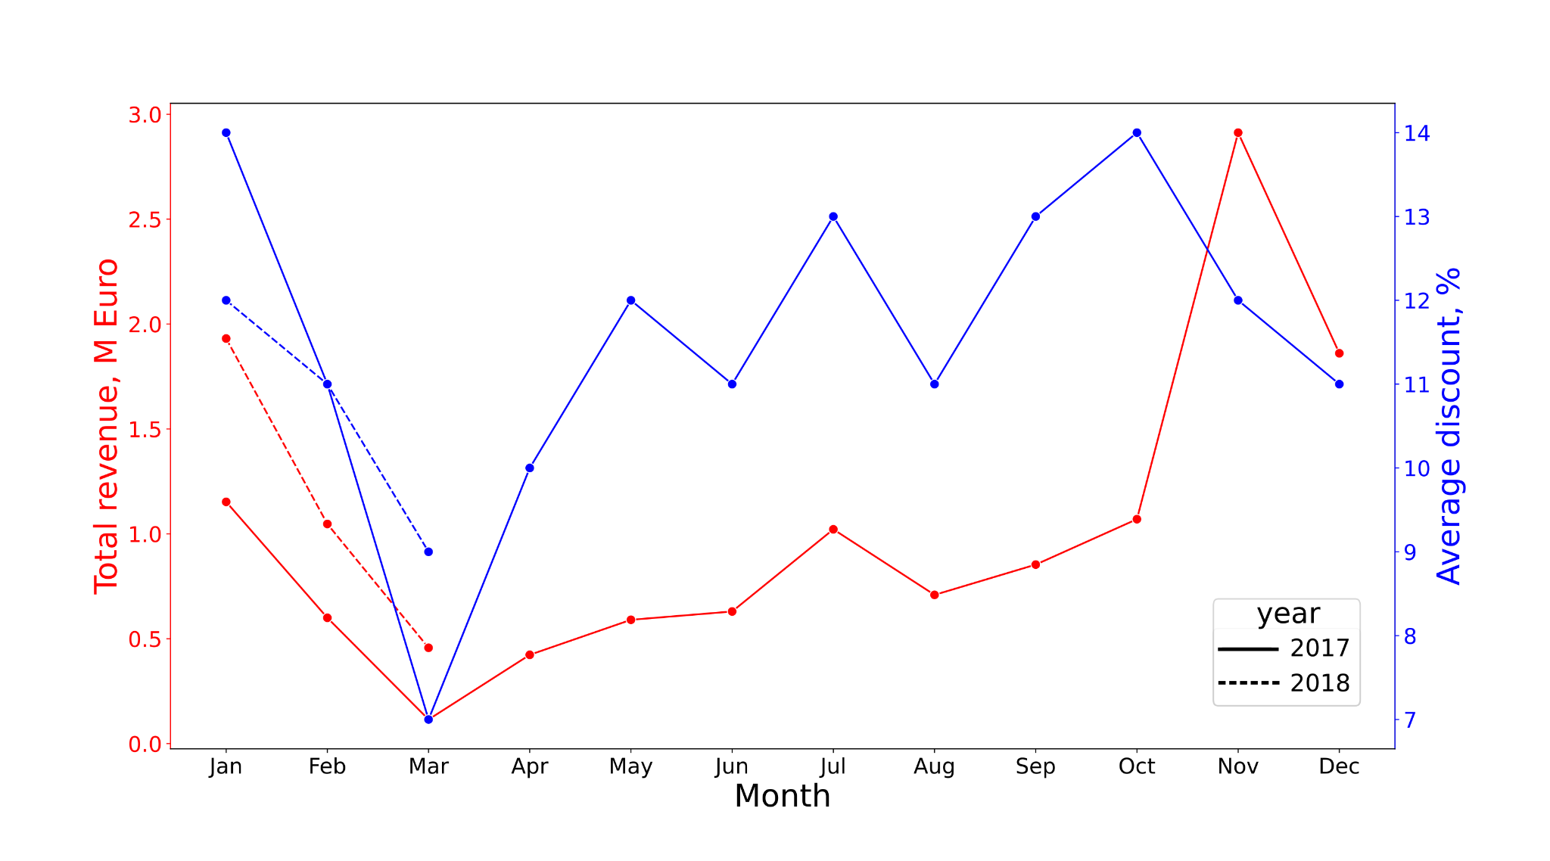
Revenue and discounts per month

Slide 4
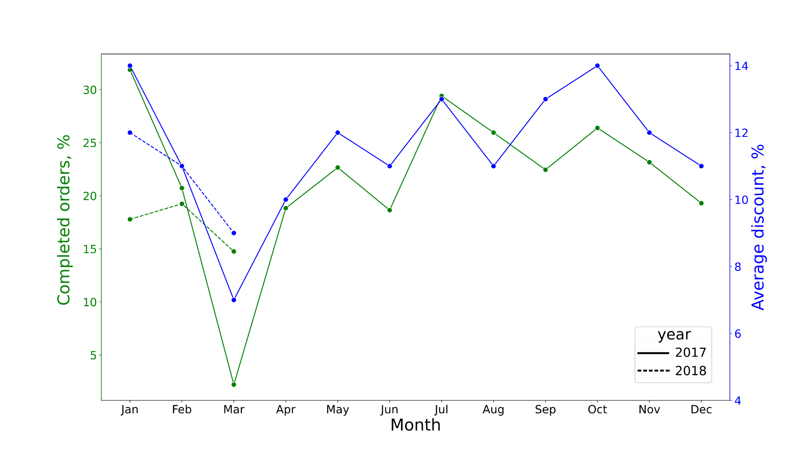
Order conversion rate and discounts per month

Slide 5
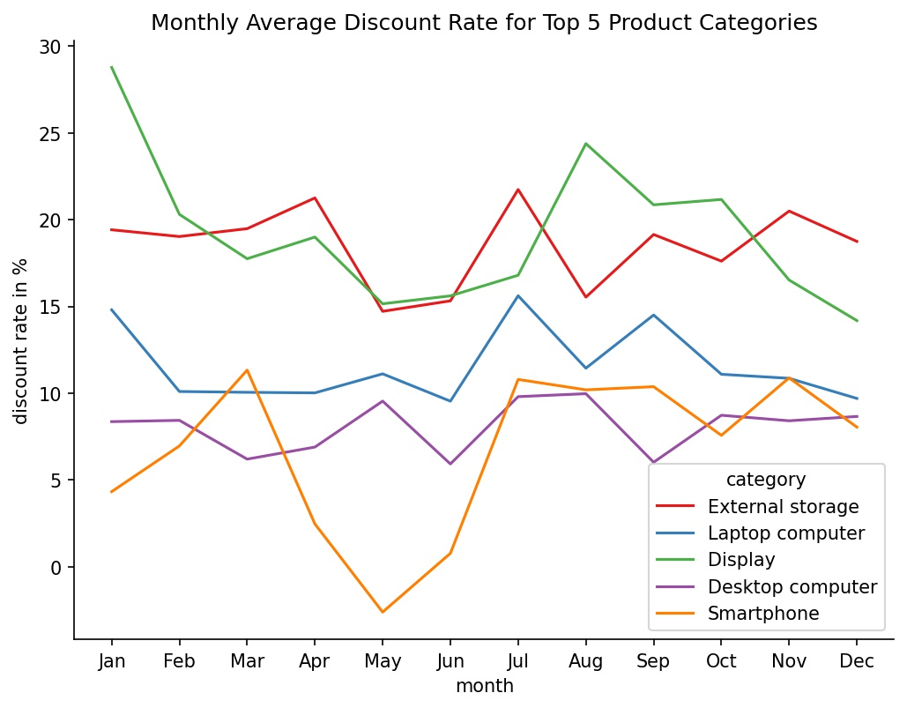
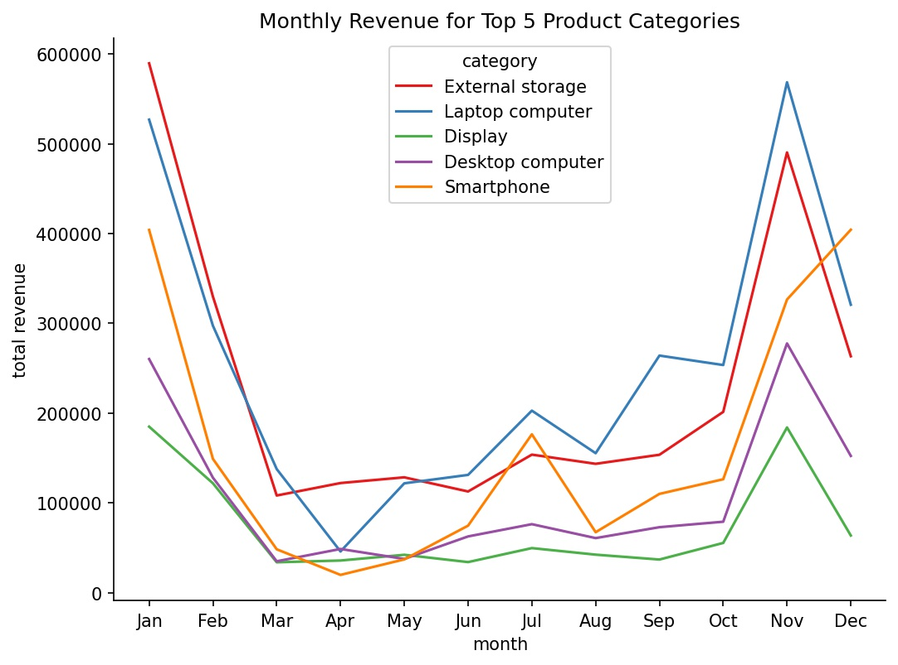
Discount rate vs revenue by product category

Slide 6
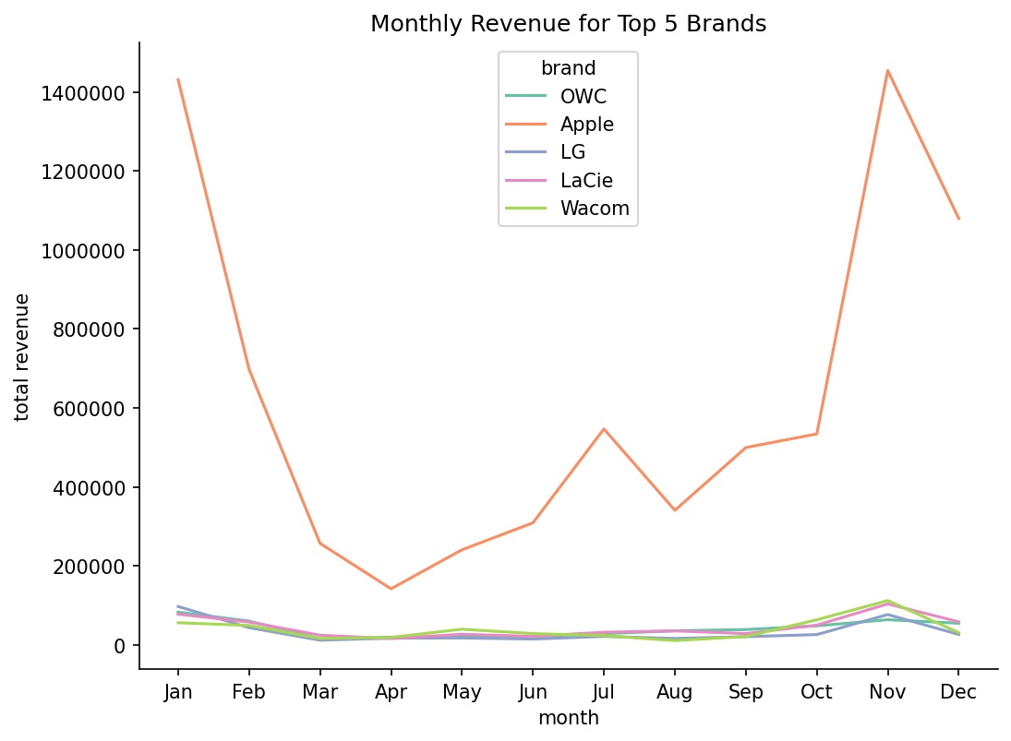
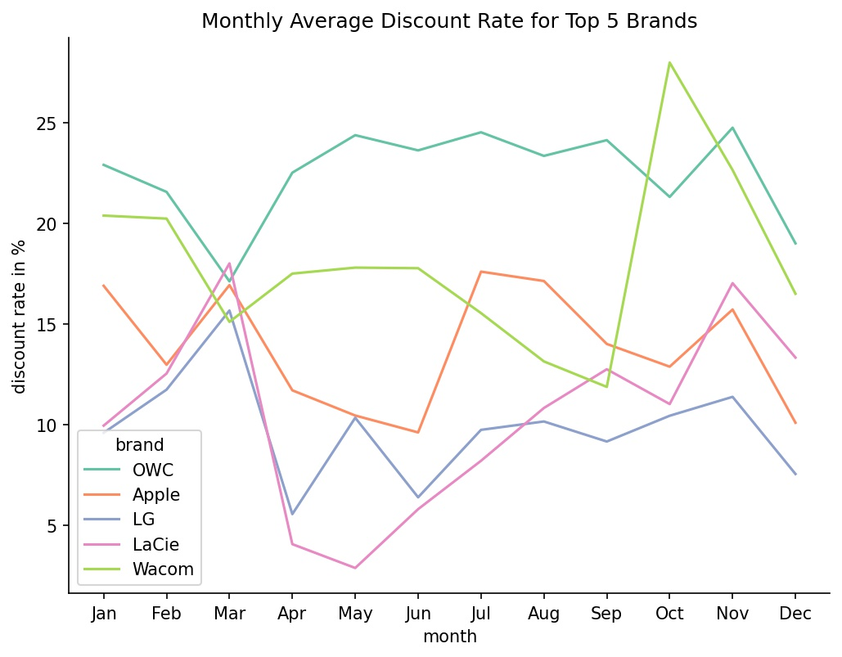
Discount rate vs revenue by brand

Slide 7
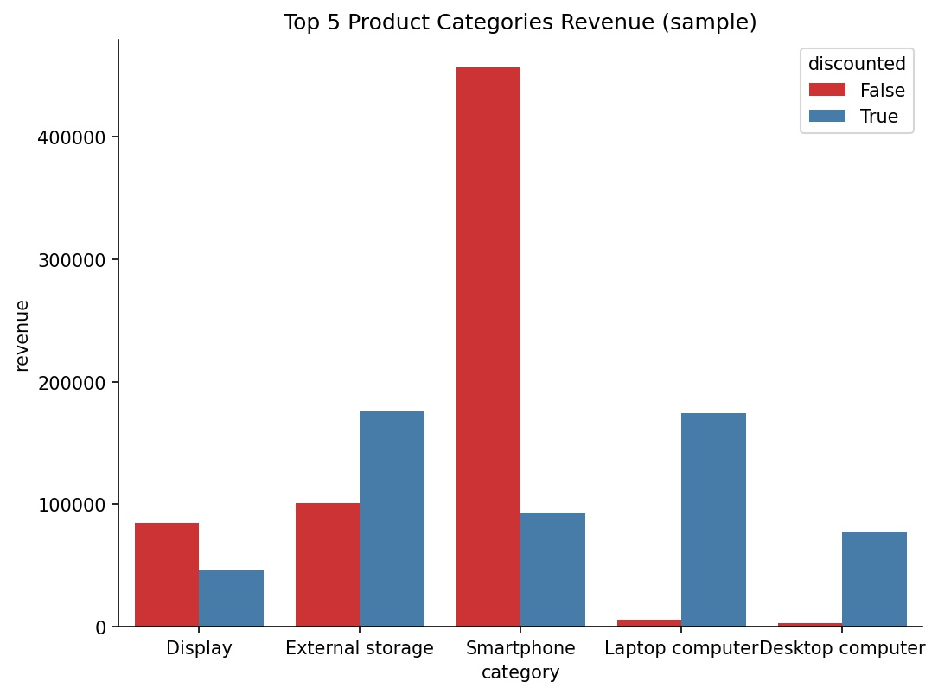
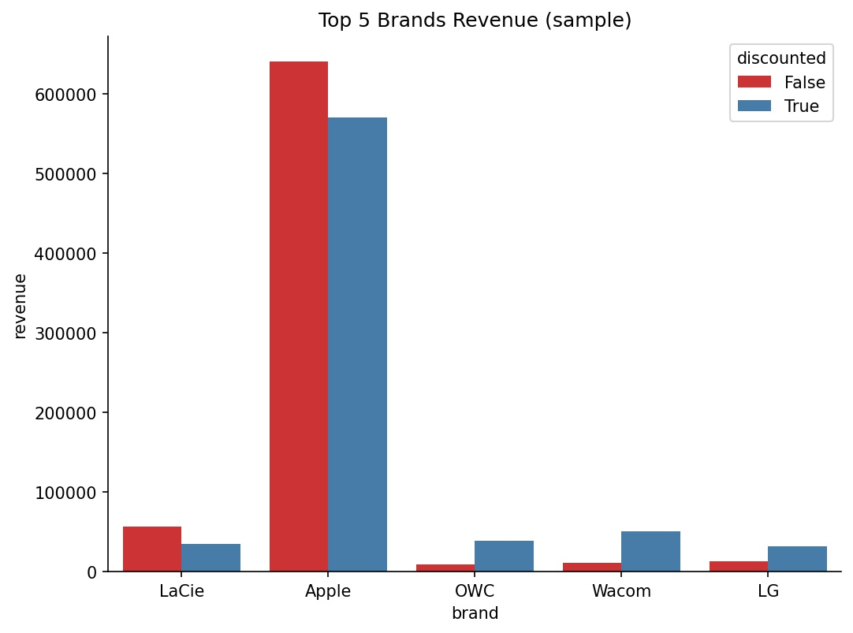
Revenue for discounted and non-discounted products
n = 1229
n = 1722
No. of discounted and non-discounted products are the same

Slide 8
Conclusions
There is a general positive correlation between discounts and revenue
There doesn’t seem to be a correlation during the end of the year regardless of categories or brand
Effect of discounts differs depending on brand and category
Discount laptop computers between June and August
No need to discount smartphones or Apple products

Slide 9
Thank you !

Slide 10
General data description
The dataset time period: Jan 2017 - Mar 2018
Overall revenue: 15 373 601 Euro
Number of items sold: 68861
Amount of discounted products: 90%
Original data was strongly corrupted: extensive data cleaning was performed

Slide 11
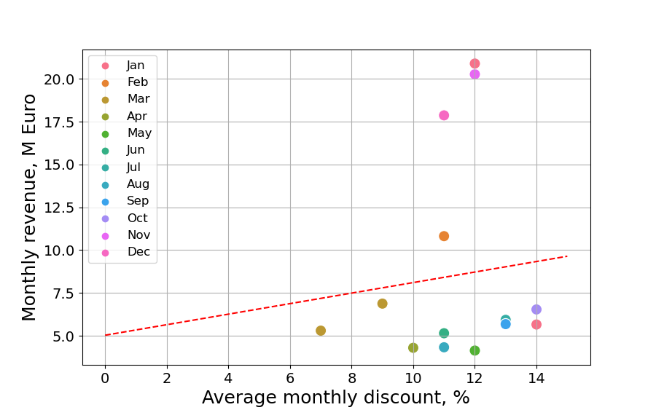
Monthly revenue vs average monthly discounts
General trend:
The higher discount the higher revenue

Slide 12
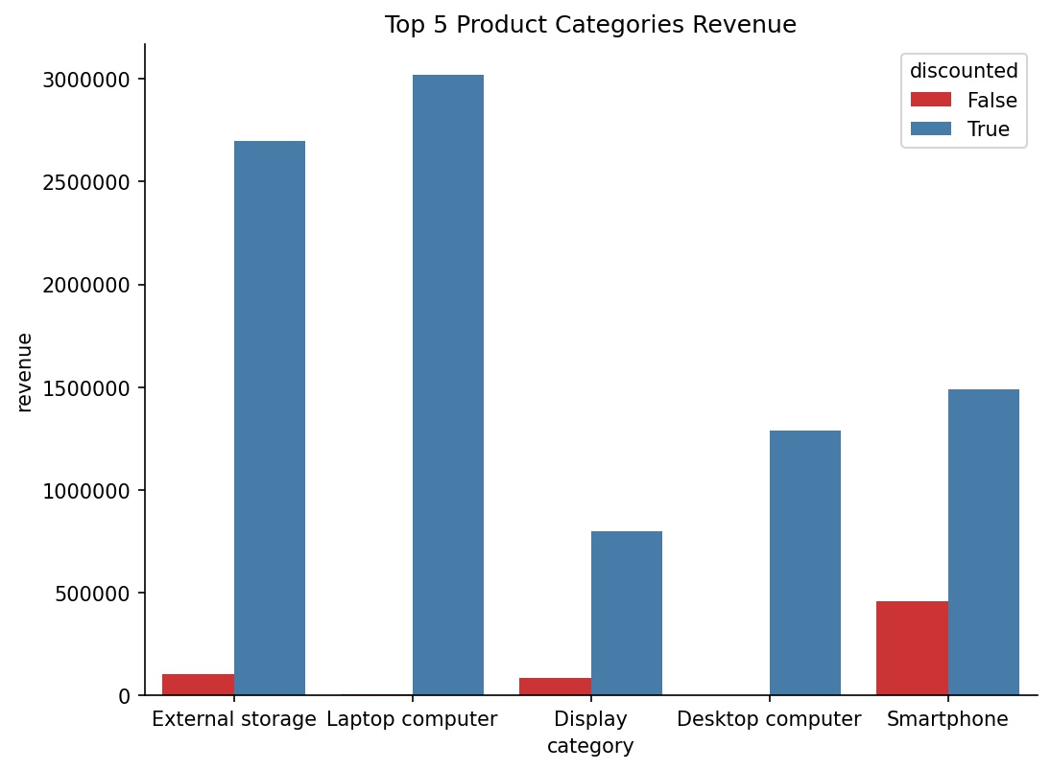
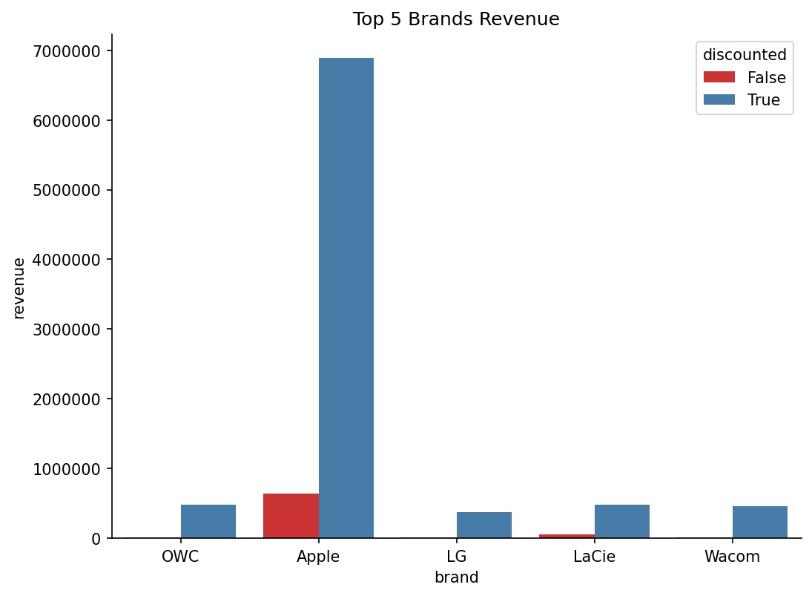
How to lie with statistics

